Slide 1
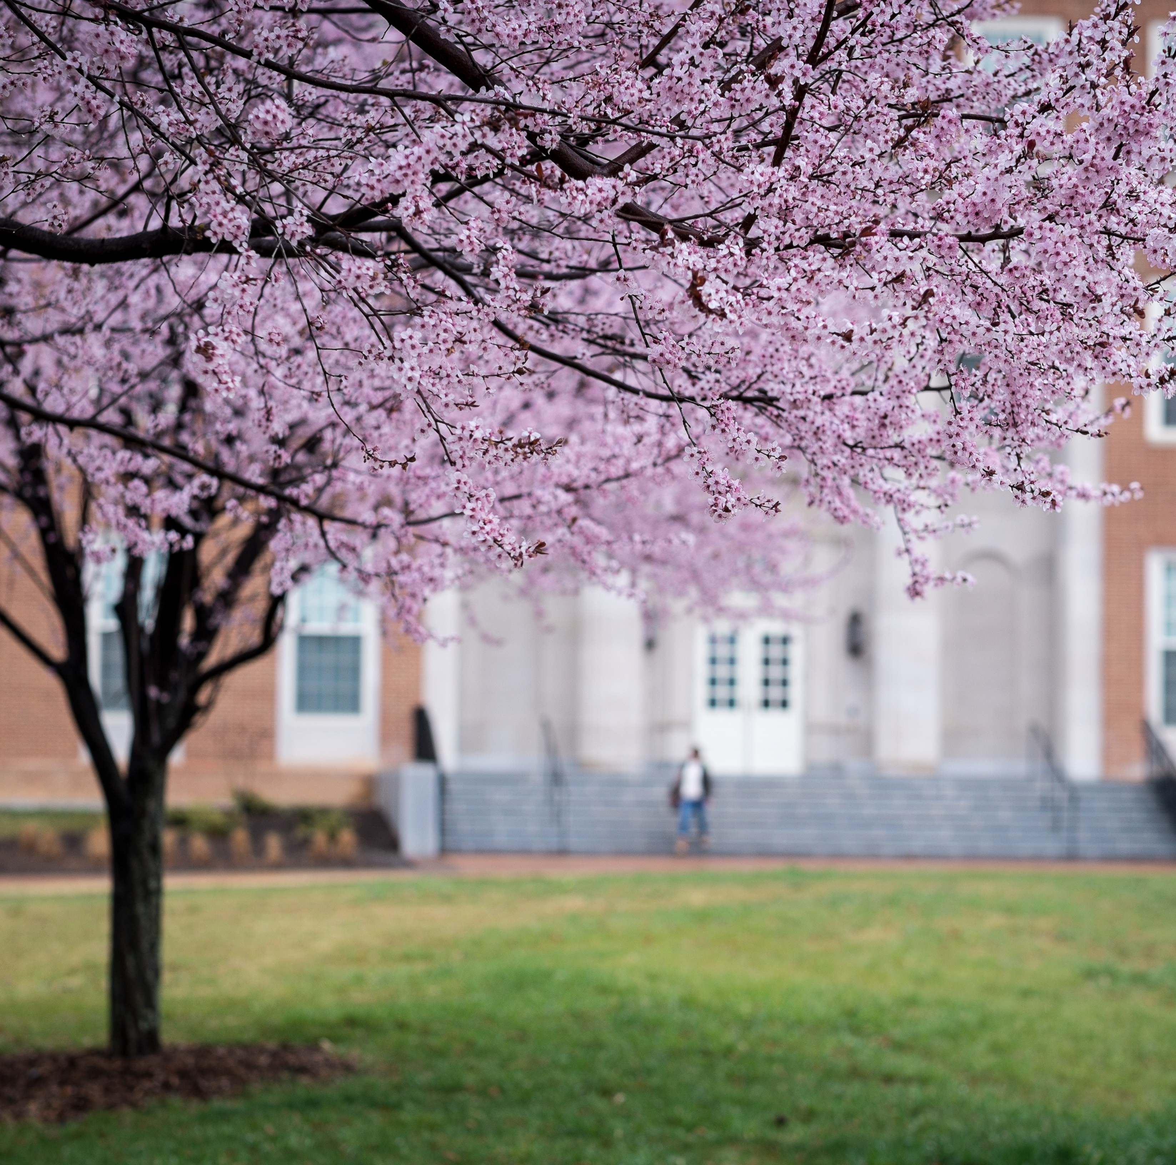
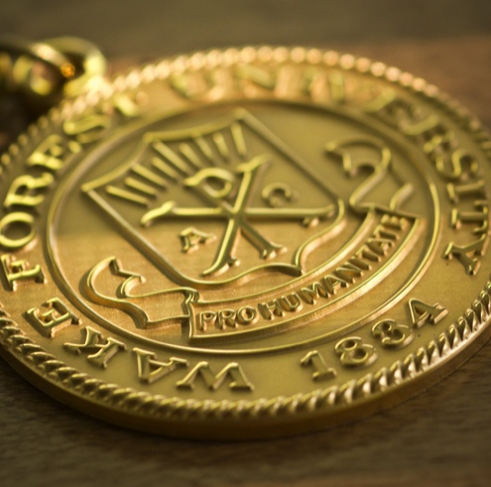
ARIMA Models
Wake Forest
School of Business
_______

Slide 2
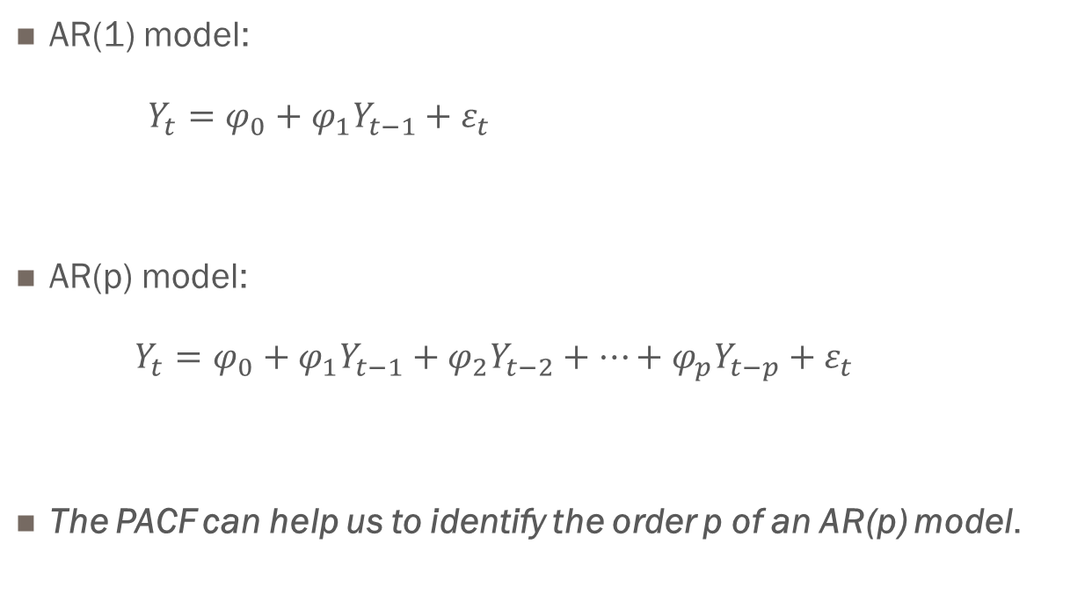
Autoregression
AR(1) model:
$Y_{t}=φ_{0}+φ_{1}Y_{t−1}+ε_{t}$
AR(p) model:
$Y_{t}=φ_{0}+φ_{1}Y_{t−1}+φ_{2}Y_{t−2}+⋯+φ_{p}Y_{t−p}+ε_{t}$
The PACF can help us to identify the order p of an AR(p) model.

Slide 3
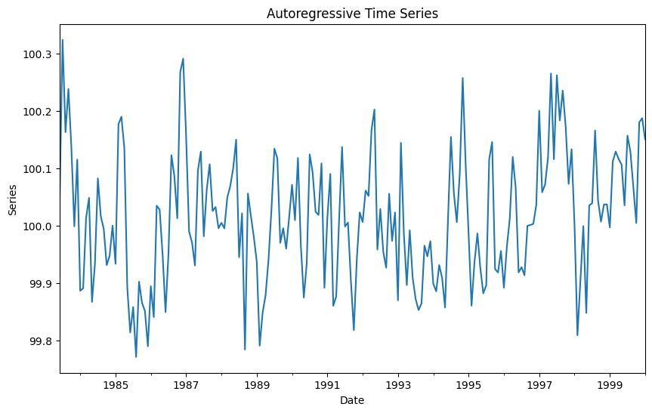
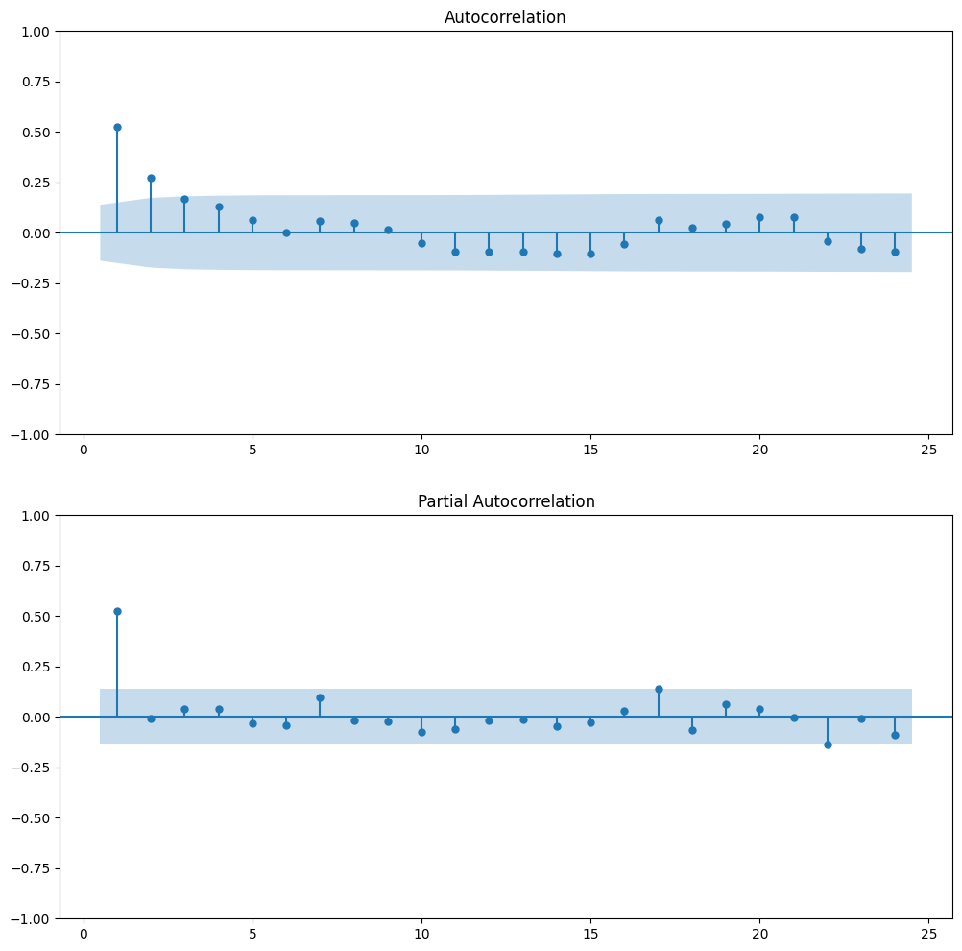
Examples of Autoregressive Time Series
AR(1) Signature
AR(2) Signature

Slide 4
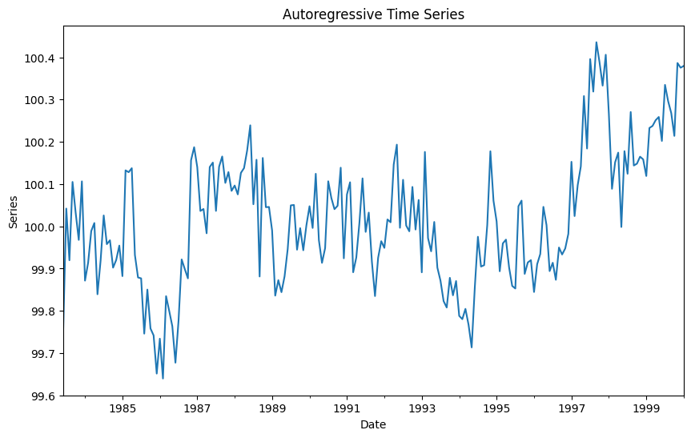
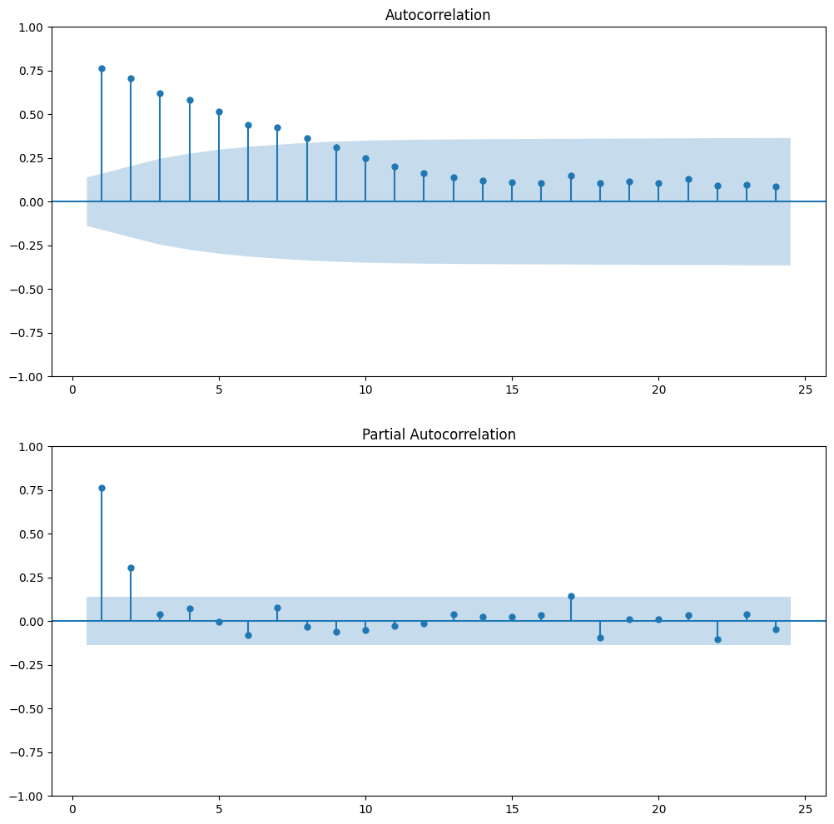
Examples of Autoregressive Time Series
AR(2) Signature
AR(2) Signature

Slide 5
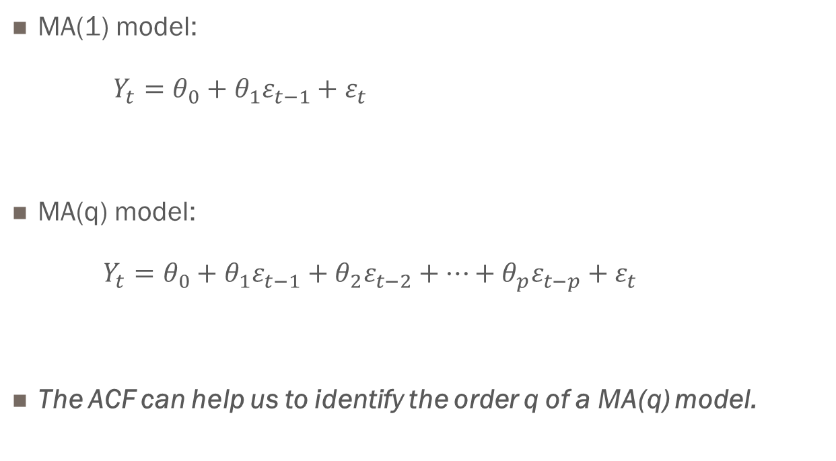
Moving Average
MA(1) model:
$Y_{t}=θ_{0}+θ_{1}ε_{t−1}+ε_{t}$
MA(q) model:
$Y_{t}=θ_{0}+θ_{1}ε_{t−1}+θ_{2}ε_{t−2}+⋯+θ_{p}ε_{t−p}+ε_{t}$
The ACF can help us to identify the order q of a MA(q) model.

Slide 6
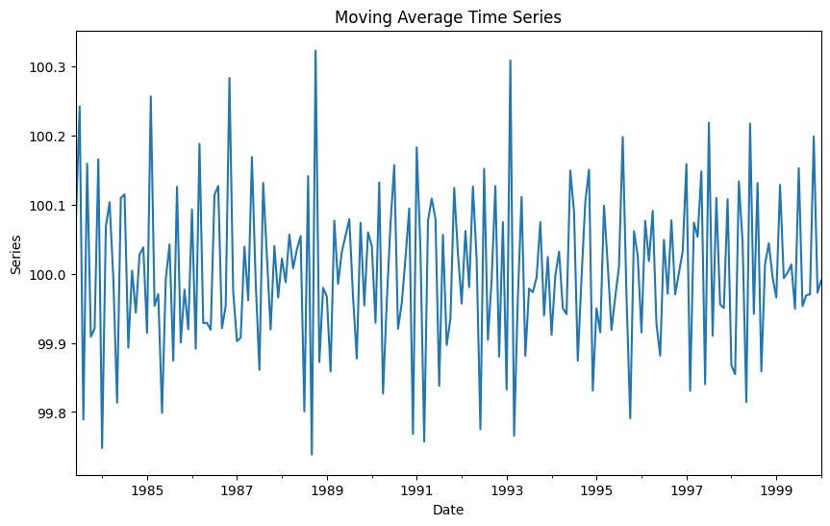
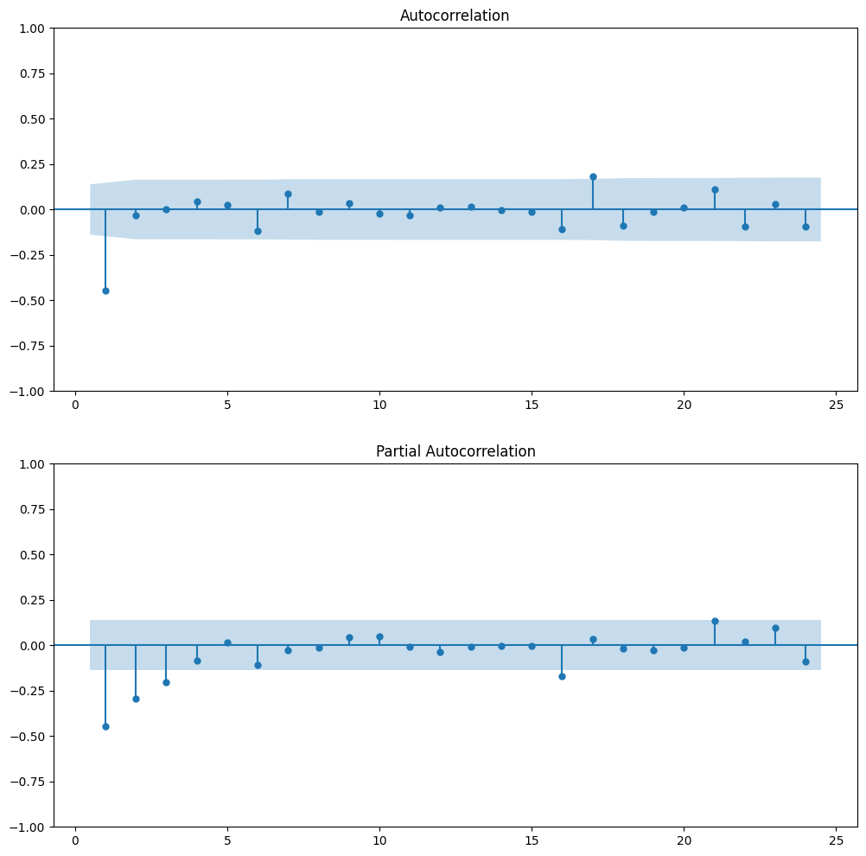
Examples of Moving Average Time Series
MA(1) Signature
MA(2) Signature

Slide 7
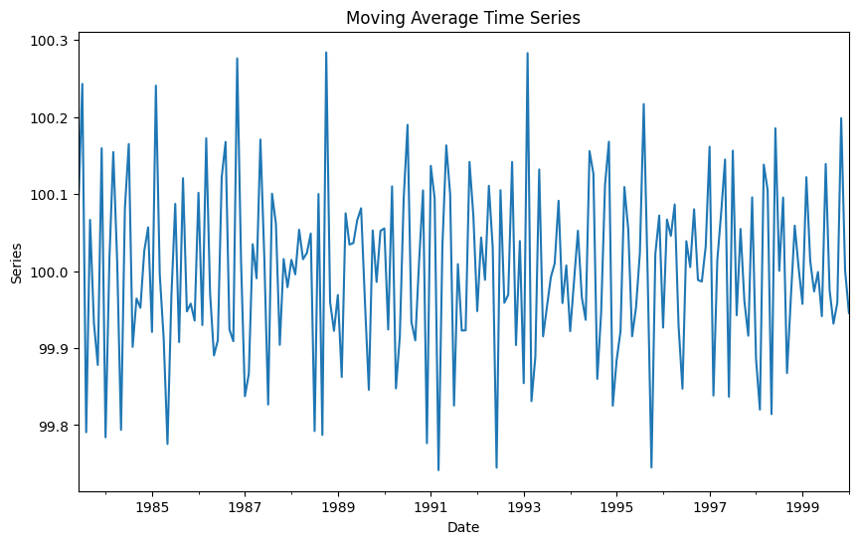
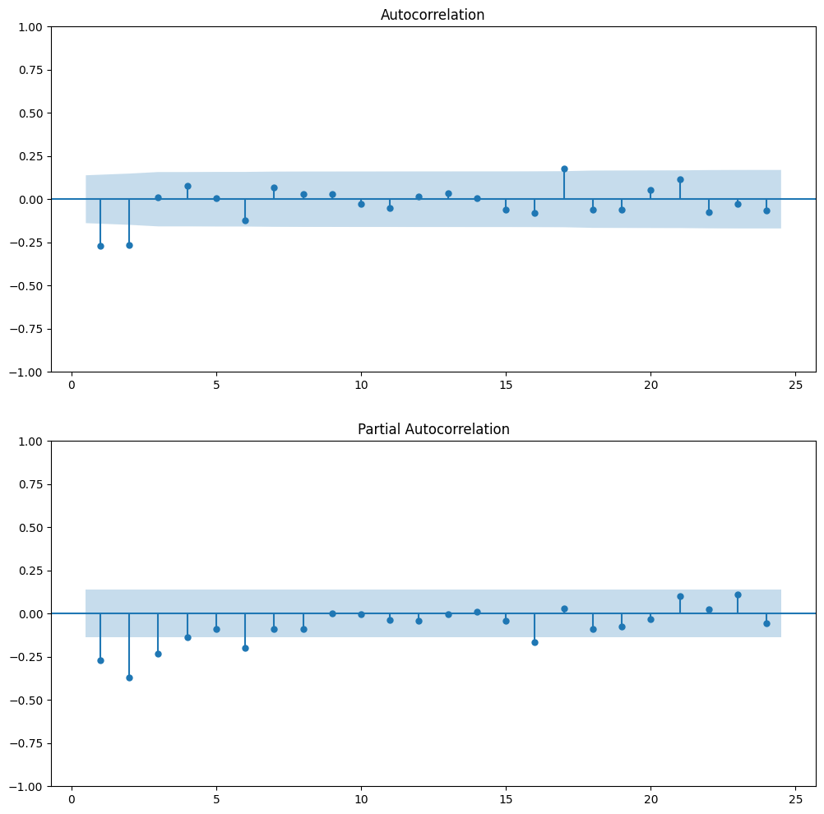
Examples of Moving Average Time Series
MA(2) Signature
MA(2) Signature

Slide 8
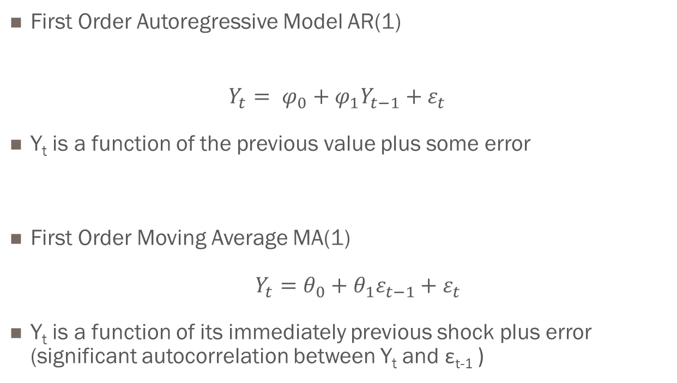
Autoregressive vs. Moving Average Models
First Order Autoregressive Model AR(1)
$$Y_{t}= φ_{0}+φ_{1}Y_{t−1}+ε_{t}$$
Y_{t} is a function of the previous value plus some error
First Order Moving Average MA(1)
$Y_{t}=θ_{0}+θ_{1}ε_{t−1}+ε_{t}$
Y_{t} is a function of its immediately previous shock plus error (significant autocorrelation between Y_{t} and ε_{t-1} )

